Slide 1



Slide 2



TA Agent Builder
EECE 798S – Agentic Systems
Zaynab Al Haj - Omar Ramadan - Rasha Malaeb
Notes:
Pitch Idea: Professor-Centric AI Agent Creator
Problem Statement:
Professors often need personalized AI agents for their classes, e.g., answering student questions, grading help, or managing resources.
Currently, integrating AI agents with class materials is cumbersome:
If using Google Drive manually, professors must upload files one by one.
Adding or updating files requires manual editing.
Sharing is limited and not easily scalable for students.
Proposed Solution:
A UI that allows professors to create AI agents for each class directly from a single platform.
Directly synced with Google Drive:
Automatically reads uploaded class materials.
Any new files added to the Drive folder are immediately available to the AI agent.
Shareable via public link: Students can interact with the agent without needing special access.
Dynamic updates: No need to manually edit or re-upload files—everything stays in sync.
Benefits:
Saves time and reduces administrative overhead.
Ensures AI agents are always up-to-date with the latest class materials.
Easy to scale across multiple classes.
Provides a seamless, modern learning experience for students.

Slide 3
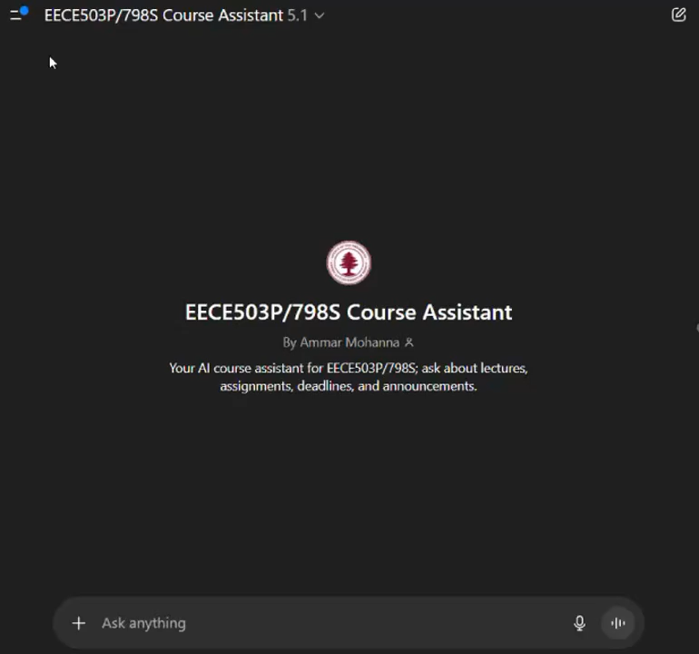
Motivation
Heavy Course Material
Professors manage many PDFs, slides, and scanned handouts every semester
Manual Updates Are Time-Consuming
Professors must re-upload materials every time they change content.
Limited Technical Familiarity
Most professors don’t want to deal with GPT settings, prompts, or custom agent links.

Slide 4
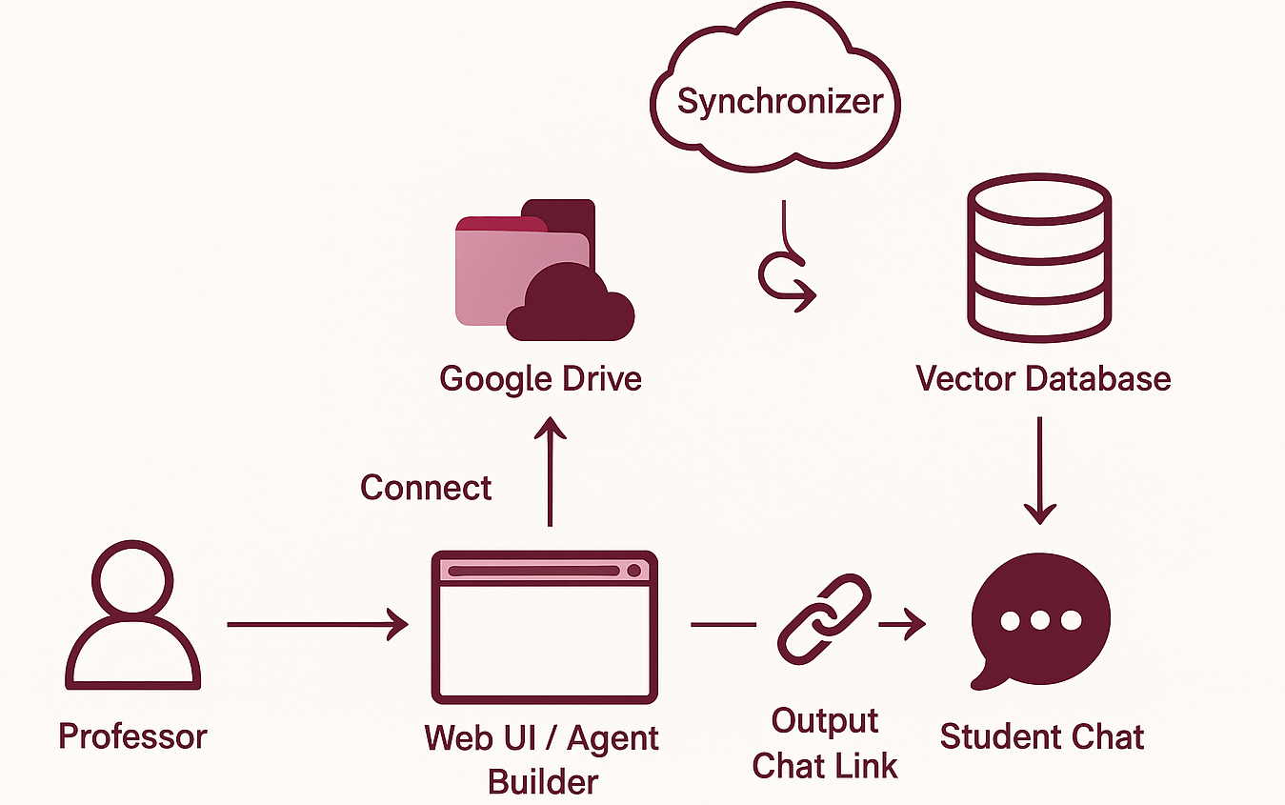
System Overview
Figure 1: System Model

Slide 5






Agent Management
Agent Builder UI
Drive Synchronization
RAG Pipeline
Agent Monitoring
Memory Management
Key Features

Slide 6
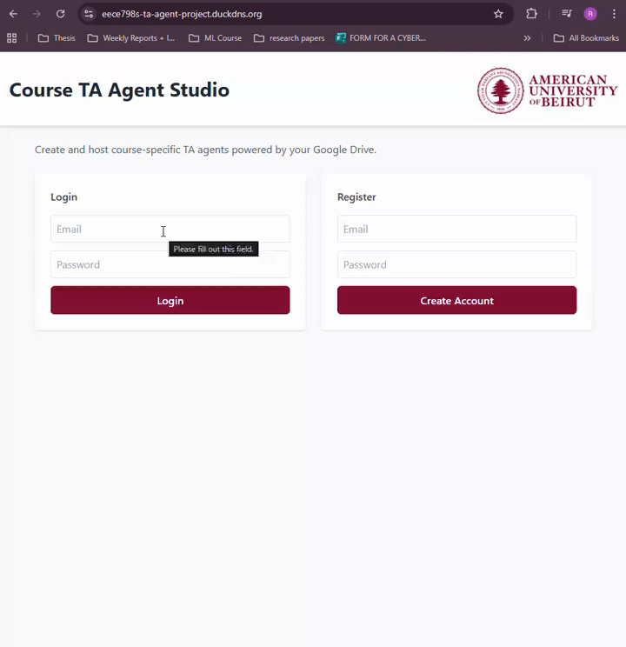
Agent Builder UI: Professors can create a course-specific agent in minutes
Professor fills a form:
Provide google drive link including list of material (pptx, word, PNG, etc.)
Choose model provider (OpenAI/Gemini)
Define agent persona
Create the agent and generate shareable link

Slide 7
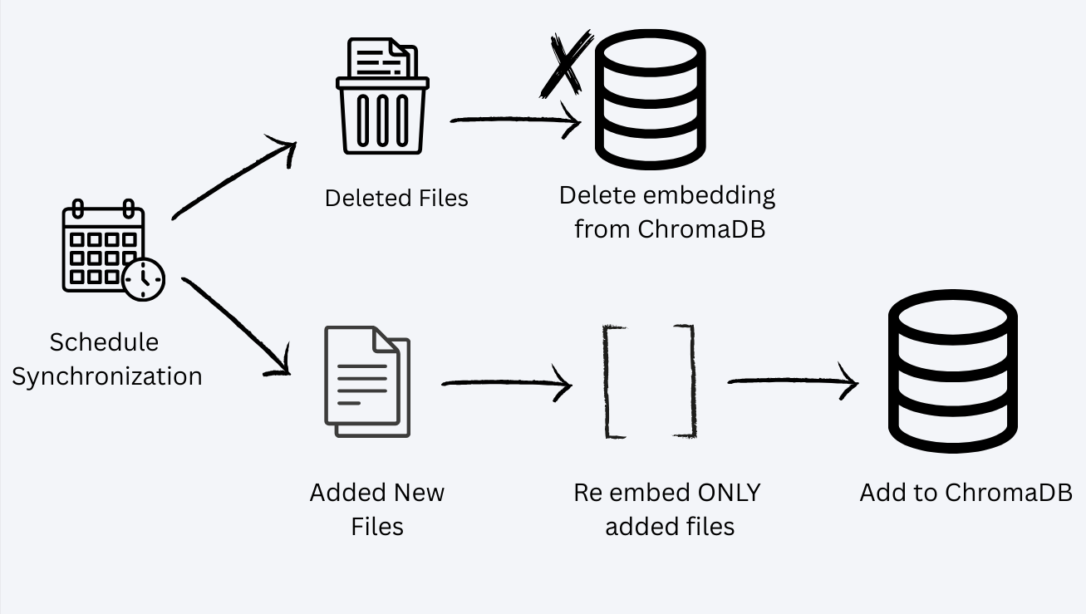
Drive Synchronization
OAuth login
Automatically detects new files
Uses OCR for scanned files
Re-embeds only changed files
Keeps course materials always in sync with Drive
Figure 2 : Synchronization Pipeline

Slide 8
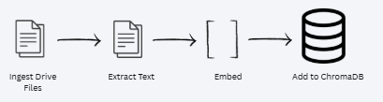
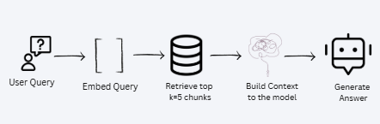
RAG Pipeline
Embeds Drive files using
OpenAI/Gemini.
Builds context for the model
using retrieved chunks.
Prevents hallucinations by anchoring
the model to the source files.
Figure 3: Rag Pipeline

Slide 9
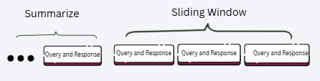
Memory Management
Sliding window of the last 12 messages
for short-term context.
Older messages are summarized as
long-term memory in addition to the RAG.

Slide 10
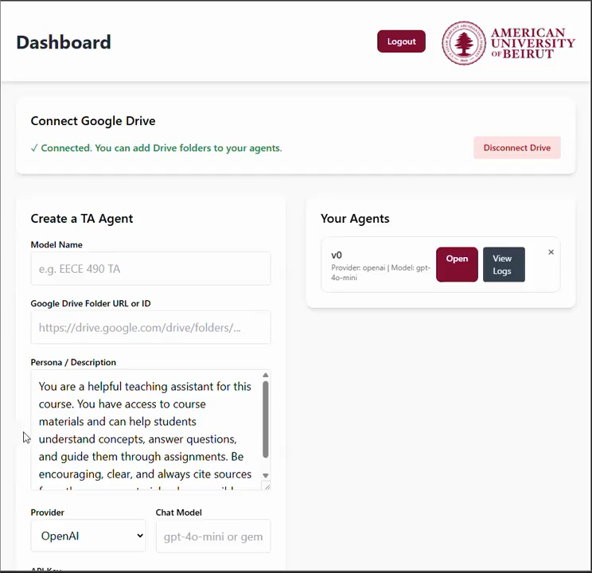
Agent Management
Admin is able to :
Update agent settings
Delete agent
Post Announcements

Slide 11
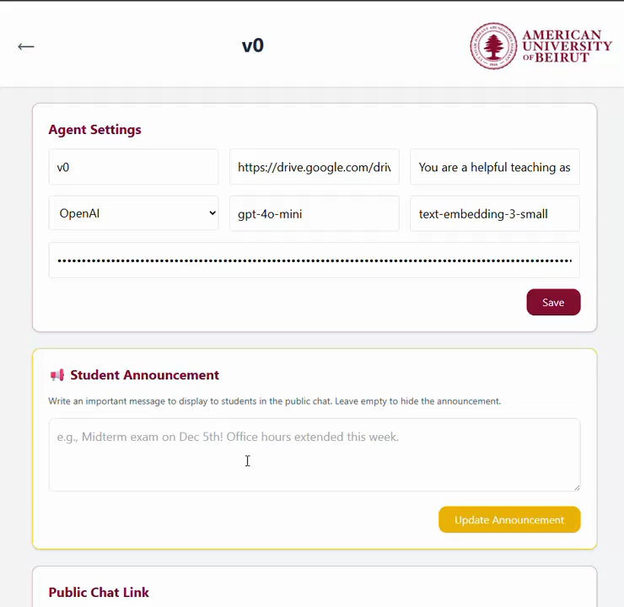
Agent Monitoring
User Query Logging: Records every student question with timestamps, enabling instructors to review interactions.
Automatic FAQ Generation: Implemented K-Means clustering architecture with LLM-based summarization to analyze & group student queries → helps identify common themes & highlight students' FAQ.

Slide 12
System Evaluation
Golden Evaluation Set:
Created a set of 50 Q&A pairs from the EECE798S course to benchmark the agent’s accuracy across different models.
Evaluated 4 Gemini models & 5 OpenAI models through several metrics (e.g. average latency in secs, total tokens, average cost per question, average semantic similarity, etc.)
Instructor Feedback Loop:
Professors reviewed the agent’s answers and provided qualitative feedback.
Professor Imad ElHaj, Professor Ali Chehab, and Professor Sanaa Sharafeddine.

Slide 13
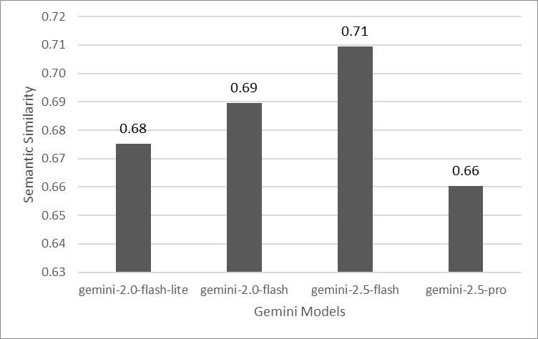
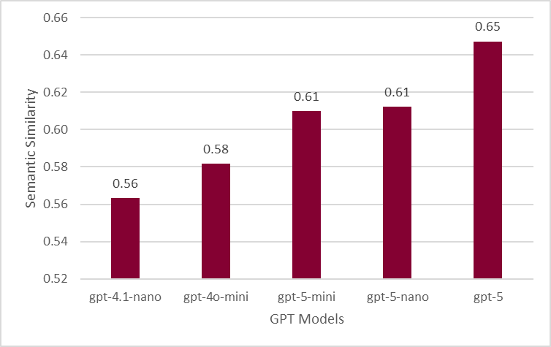
Results - Average Semantic Relation
Measures how semantically close the model’s generated answers are to the ground truth.

Slide 14
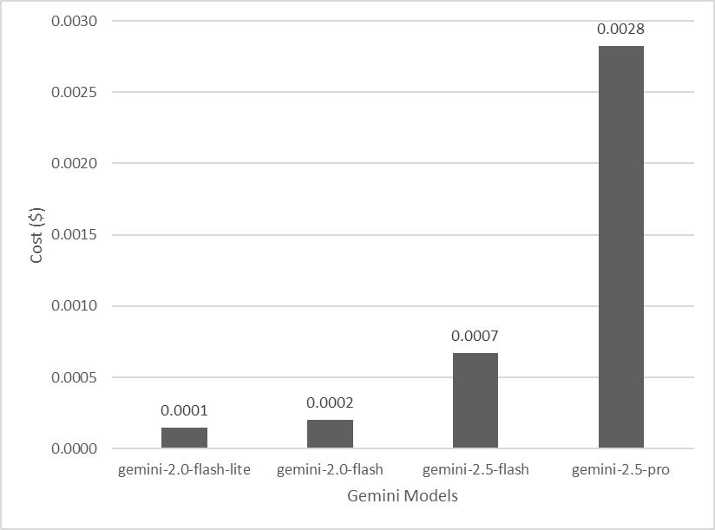
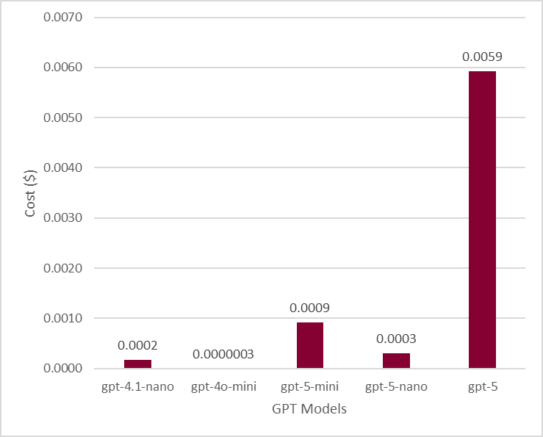
Results - Average Cost per Question
Average dollar cost per query based on provider pricing.

Slide 15
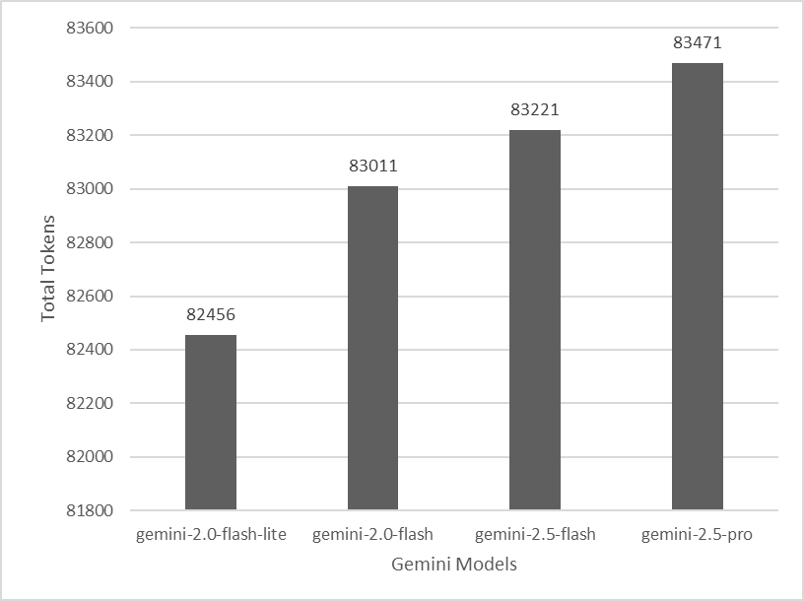
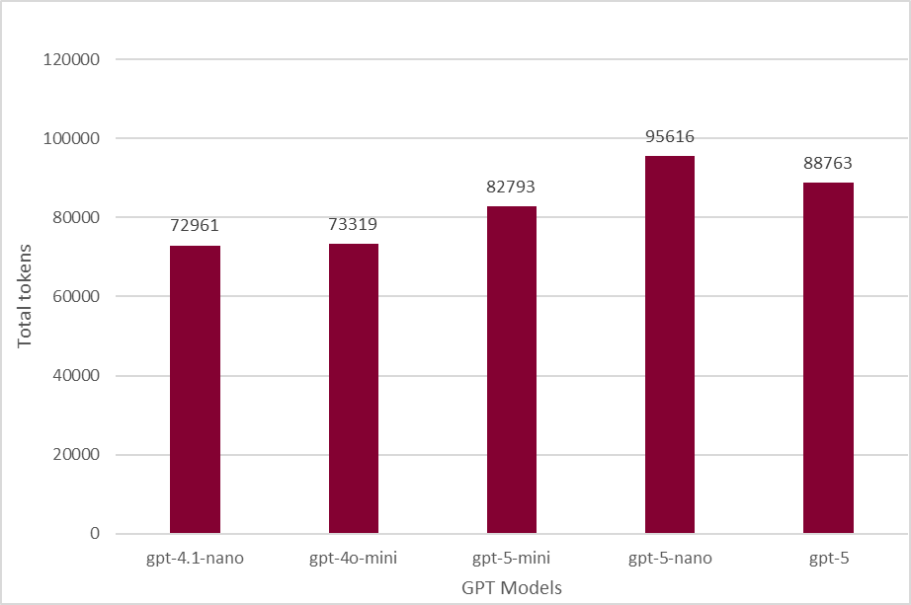
Results - Total Tokens
Sum of tokens consumed across all evaluated questions (processing overhead).

Slide 16
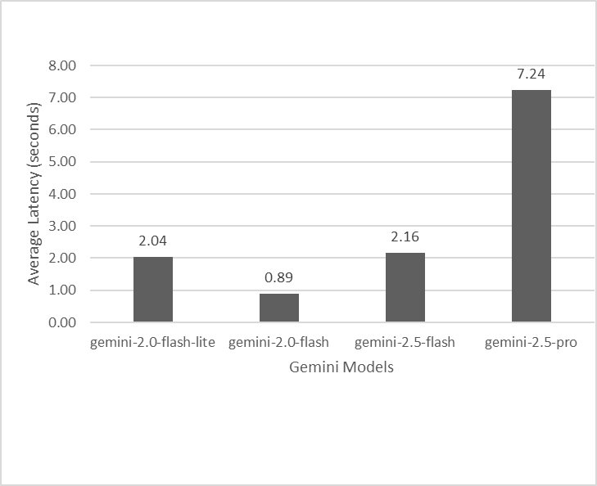
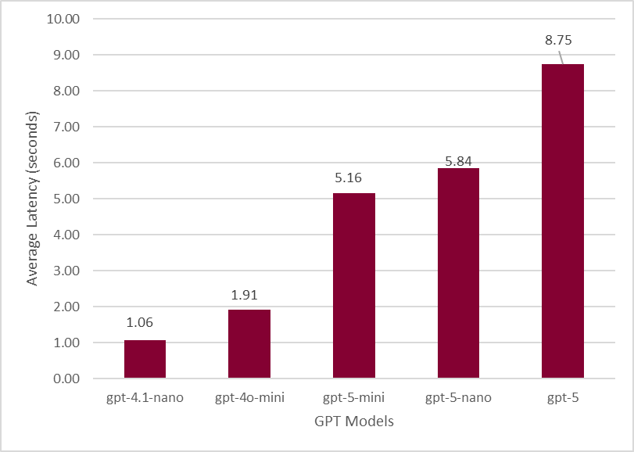
Results - Average Latency (seconds)
Average time to return an answer.

Slide 17
Project Demo

Slide 18
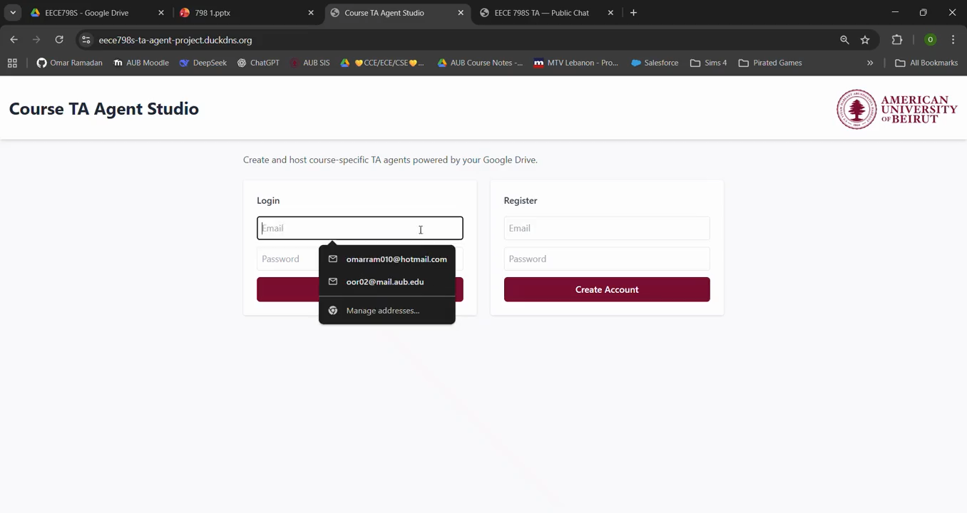

Slide 19

THANK YOU

